Slide 1
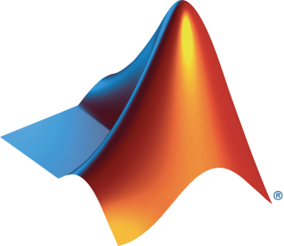
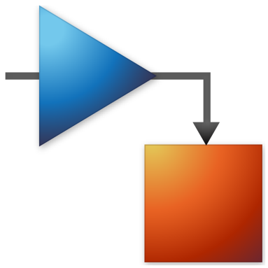
University and MathWorks Present: Object Oriented Programming Onramp

Slide 2
Today:
6:15 pm – 6.30 pm: Set-up
Intro to Object Oriented Programming
Create MathWorks account
Log in to Object Oriented Programming Onramp / Test MATLAB Online
6.30 pm – 8.00 pm: Object Oriented Programming Onramp (on your own)

Slide 3
Object-Oriented Programming
Notes:
Object-oriented programming (OOP) is a computer programming model that organizes software design around data, or objects, rather than functions and logic.

Slide 4
Progression of Programming Techniques
Data
Value
Variable
Container (e.g., struct, table)
(Properties)
Class
Increasing level of sophistication
Command Line
Script
Function
(Methods)
Algorithm
Notes:
The most functional way of representing data and algorithm is clubbed together to form a class.

Slide 5


Scenario: Sensor array locating a weather balloon
Balloon transmits a signal
Sensor array receives the signal (blip)
Goal: Process the blip to compute the angle of arrival (AoA)
How can we implement this scenario?
How can we make it more robust?
Notes:
Lets now take a look at our application example.
Sensor arrays
A sensor array is a collection of sensors, often arranged in a line, that is used to sample a medium such as air, water, or the ground for radar, sonar, cellular communications. By collecting time samples from multiple points in space, you can extract additional information from the medium being sampled. The Navy’s AEGIS radar system is an example of a sensor (or phased array). It uses >4000 elements.
Tasks
Our example uses a sensor array to determine the direction of arrival (DOA) of multiple distant electromagnetic sources, such as radio beacons and radar transmitters. Sensor array processing is in fact very similar to regular signal processing except that you are primarily sampling space instead of time. You can apply similar techniques such filtering in a particular direction (known as beam-forming). For direction finding you use the same techniques used for spectral analysis for finding the multiple frequencies in a signal.
Approach
The approach we will use to implement the applications is
Data to represent: We will begin by reviewing the data items that we will need to represent here…
Operations to implement: … and then the operations that we will need to implement on those data elements.
Possible Great demo style piece: To show you what we are aiming at producing today, here is a finished report on the application. (Open finished application report, test_value_complete) It includes…
the creation of the of a sensor array object, based on a class that we will design
…Examples of interacting with the object and its properties
Calling operations or methods on an object to plot the data
and calculate the angles of arrival

Slide 6



Object-Oriented Terminology
Class
A blueprint for creating objects; a concept
Properties (data, state)
Methods (algorithms, behavior)
Object
A specific instance of a class
Lexi
Methods
eat()
sit()
Properties
Breed = “Alaskan Husky”
Age = 8
Color = [“Black”, “White”]
bark()
Class: Dog
Methods
eat()
sit()
Properties
Breed
Age
Color
bark()
Luna
Methods
eat()
sit()
Properties
Breed = “Chihuahua”
Age = 4
Color = “Brown”
bark()
Notes:
First of all some concepts… With object oriented programming we treat the application as a collection of things or categories rather than just a sequence of tasks.
A class
When creating software applications, the things or categories that you could represent include physical objects, such as a car or an organism; a virtual entity, such as a financial market; or information, such as a set of test results. In object oriented programming, these are represented as classes. Data elements, or state, are represented as class properties and operations are implemented as class methods.
An object
An object is an instance of a class - when a program executes, the object is created based on its class and behaves in the way defined by the class. The values stored in MATLAB variables all belong to a class.
These values include not only what you might normally consider objects, such as a time series or state space object, but also simple doubles.
Identifying MATLAB classes
In MATLAB, the class of a variable is displayed in the output of the whos command. For example
>> clear
>> a=1;
>> str='Hello';
>> whos
Here we see the class of each variable

Slide 7
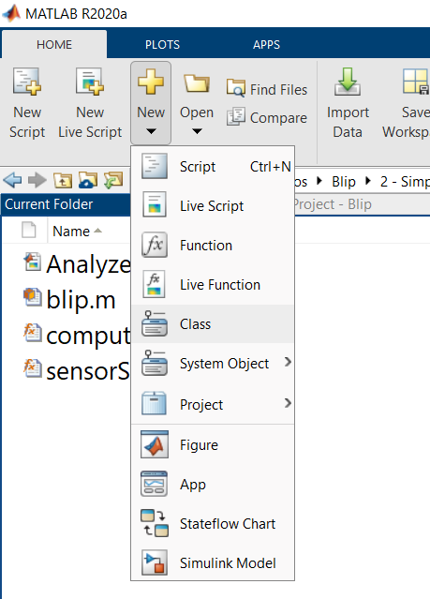
Building a Simple Class
Define a class blip
From the class, create the object balloon
Use the object in place of the structure

Slide 8
Encapsulation
Separates the interface from the implementation
Simplifies object use
Becomes a building block
Sensor
Sensor
Speed of Light
Noise Ratio
Sensor Reading
Number of Sensors
etc.
Synthesize measurements
Plot Results
Determine Peaks
Sensor Spacing
Compute FFT
Compute AoA
Notes:
Encapsulation serves in hiding irrelevant data from users.

Slide 9
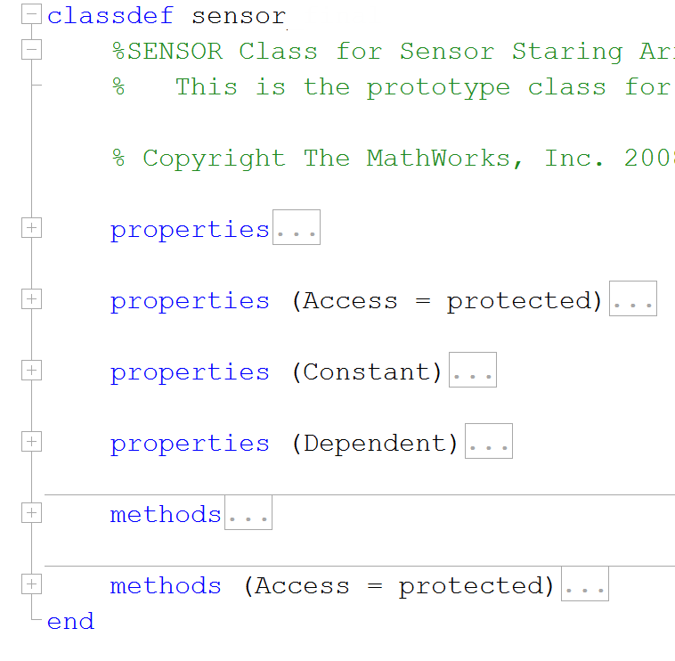
Applying Attributes
Control access
Access = public
Access = protected
Restrict modification
Constant
Dependent
More on attributes
Notes:
Attributes are data members inside a class or an object that represent the different features of the class. They can also be referred to as characteristics of the class that can be accessed from other objects or differentiate a class from other classes.

Slide 10
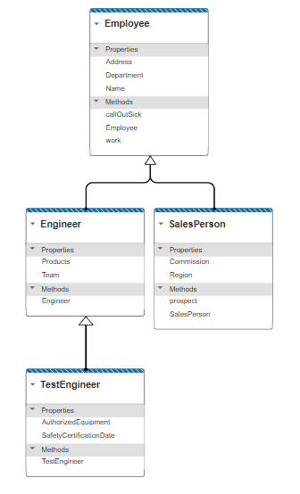
Inheritance: Subclasses and Superclasses
classdef Engineer < Employee
...
classdef TestEngineer < Engineer
...
Notes:
Inheritance is a feature or a process in which, new classes are created from the existing classes. The new class created is called “derived class” or “child class” and the existing class is known as the “base class” or “parent class”

Slide 11
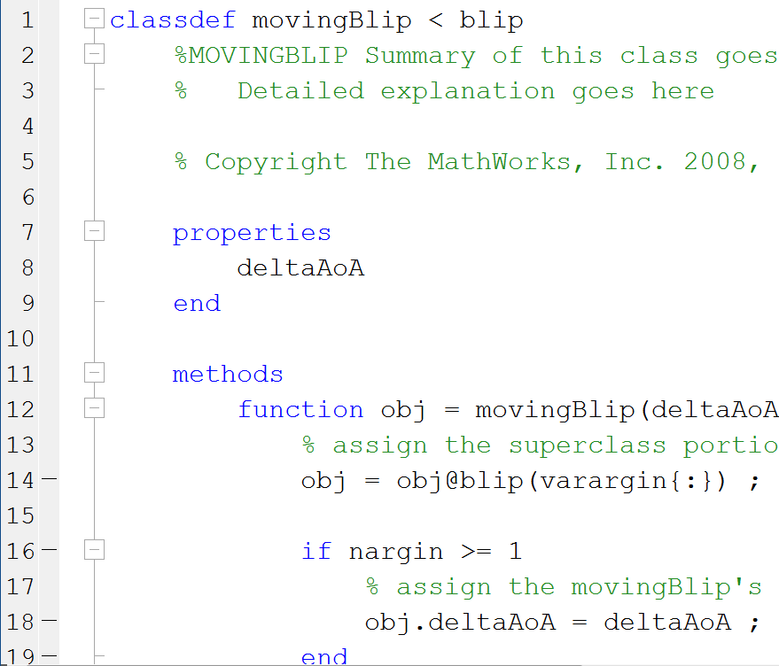
Inheritance
Subclass substitutes for the superclass
Allows re-envisioning and re-implementing the superclass
Builds on proven code
Allows inheriting from the base MATLAB classes

Slide 12
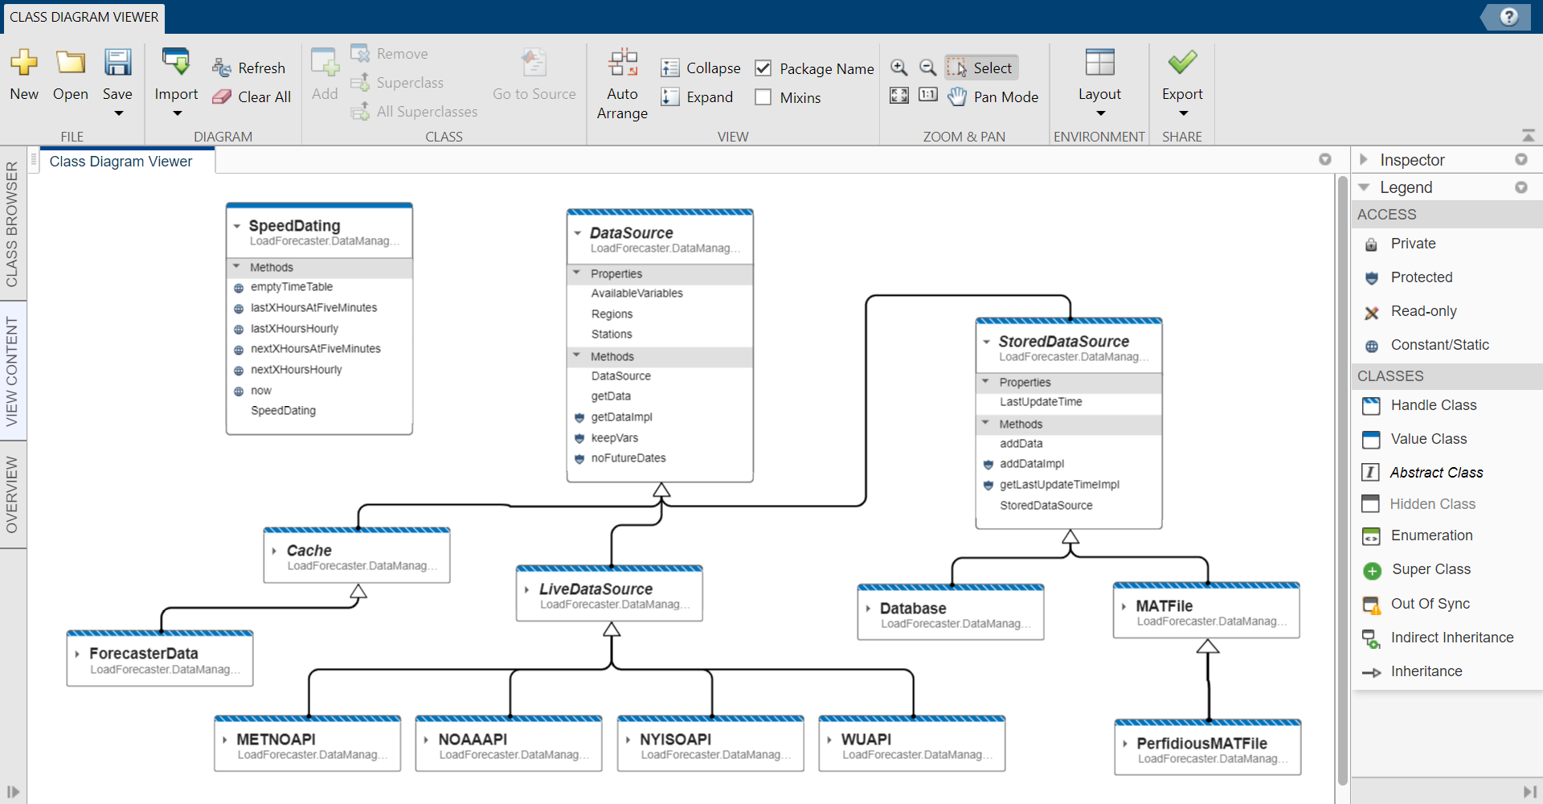
View Class Hierarchies with MATLAB’s Class Diagram Viewer

Slide 13
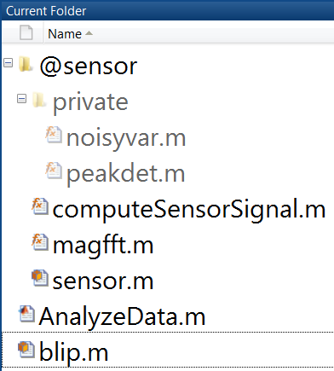
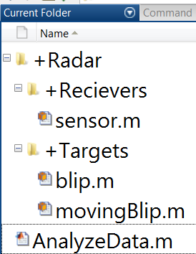
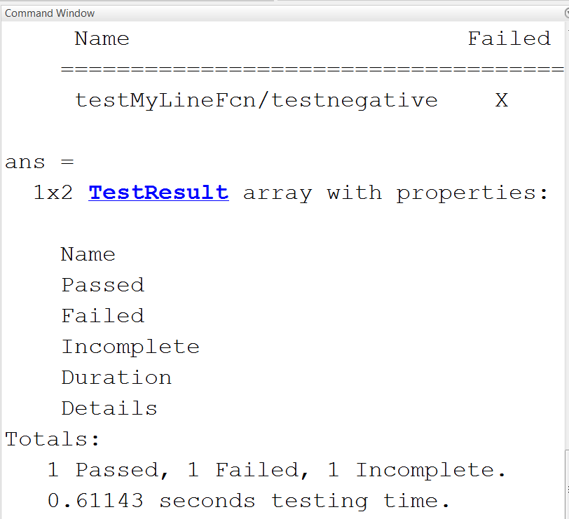
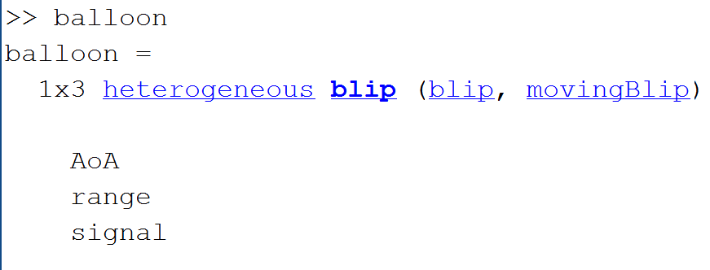
Doing More with OOP in MATLAB
Classes in multiple files
Packages for creating namespaces
Mixings and heterogeneous arrays
Meta class information
Custom indexing
Unit testing

Slide 14
How can Object Oriented Programming be used in the real world?

Slide 15
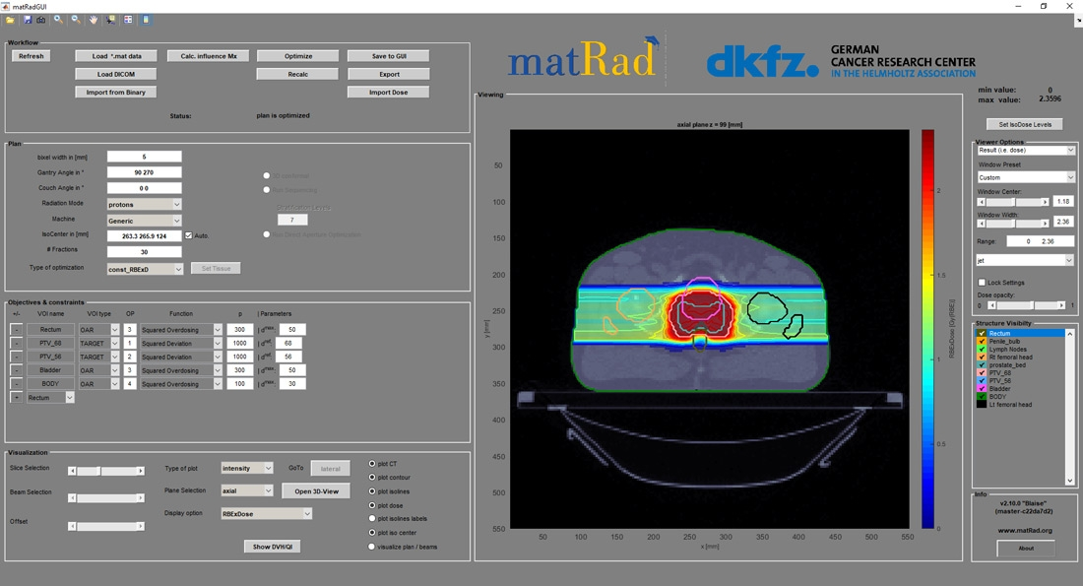
German Cancer Research Center Develops MATLAB Based, Open-Source Toolkit for Radiation Therapy Planning
Challenge
Provide researchers with an open-source alternative to commercially developed radiotherapy treatment planning software
Solution
Use MATLAB to develop and freely share matRad, a multimodality dose calculation and optimization toolkit
Results
Clinically accurate treatment plans quickly produced
Toolkit cited in more than 40 published peer-reviewed papers
Dosing calculations accelerated on multiple computing cores
The matRad interface, with workflow, plan, optimization, and visualization controls.
“Developing matRad in MATLAB enabled us to make the software highly versatile: users can interact with the software via an interface or via the MATLAB command line, develop their own functions, and use matRad for both research and teaching.” - Dr. Niklas Wahl, German Cancer Research Center (DKFZ)
Link to technical article
Notes:
Industries: Biotech and Pharmaceutical
Application Areas: Computational Biology, Image Processing and Computer Vision
Capabilities: Algorithm Development, Data Acquisition, Data Analysis, Mathematical Modelling, Parallel Computing
Products Used: MATLAB, Image Processing Toolbox, MATLAB Compiler, Optimization Toolbox, Parallel Computing Toolbox
Country: Germany
Published in 2020
Figures/images available in online version
Product names are current at time of technical article publication.
Developing matRad, an Open-Source Dose Calculation and Optimization Toolkit for Radiation Therapy Planning
By Dr. Mark Bangert, German Cancer Research Center (DKFZ), Prof. Oliver Jäkel, German Cancer Research Center (DKFZ) and University of Heidelberg, Dr. Niklas Wahl, German Cancer Research Center (DKFZ), and Dr. Hans-Peter Wieser, Ludwig-Maximilian-Universität München (LMU Munich)
Radiotherapy, surgery, and chemotherapy constitute the three pillars of cancer treatment. One key element of radiotherapy is a heavily computer-aided process known as radiation treatment planning. In this process, oncologists and other clinicians rely on treatment planning software to accurately simulate the effect of radiation on patient tissue and to optimize the radiation dose so as to ensure tumor coverage while sparing surrounding tissue and organs.
Commercially developed radiotherapy treatment planning software is proprietary and closed-source, which limits its value to researchers working to advance treatment planning technology. As a result, many institutes and universities either invest significant effort in developing and maintaining their own software or use open-source packages, most of which focus on only a single step in treatment planning or a single radiation modality.
Our development team at the German Cancer Research Center (Deutsches Krebsforschungszentrum, or DKFZ) has created matRad¹, an open-source, multimodality dose calculation and optimization toolkit for radiation treatment planning (Figure 1). Because matRad is written entirely in MATLAB®, researchers can easily modify the code to evaluate new algorithms. MATLAB excels at performing the many sparse matrix operations involved in treatment planning; as a result, matRad produces clinically accurate treatment plans as quickly and easily as its commercial counterparts.
Using matRad in a Treatment Planning Workflow
The matRad package includes MATLAB scripts, functions, and classes that span the entire treatment planning workflow, from setting treatment parameters and optimizing the plan to visualizing and evaluating the results. Researchers initiate each step in this workflow either in the matRad interface or from the MATLAB command line.
A researcher first imports computer tomography (CT) scan data from one of their own patients or from one of the anonymized patient cases provided by matRad. The software reads the data from MATLAB files or from files in the Digital Imaging and Communications in Medicine (DICOM) and DICOM-RT standard formats using functions from Image Processing Toolbox™.
Next, the researcher specifies parameters for the treatment plan and the radiotherapy machine to be used. These parameters could include the number of angles for the gantry (used to position the radiation source around the patient) and the treatment modality to be applied: intensity-modulated photons, scanned protons, or scanned carbon ions. The parameters can be set via the interface or by editing the matRad script (Figure 2).
matRad generates the beam geometry based on the parameters specified. The researcher then invokes the function for matRad dose calculation, which computes a matrix of the dose delivered to individual regions of the target tumor and to surrounding normal tissue for each radiation source element (Figure 3).
Finally, the researcher defines clinical objectives and constraints for the treatment. These might include the prescribed minimum dose to be delivered to the tumor and the maximum dose allowed to reach a nearby organ. After translating these clinical objectives and constraints into mathematical objectives and constraints, matRad runs an optimization solver to find the best dose distribution. For the optimization, matRad can be set up to use fmincon from Optimization Toolbox™ or IPOPT, an open-source optimization software library written in C++ and imported into MATLAB as a MEX file. The results of the optimization can be reviewed in matRad in a variety of plots and visualizations (Figure 4).
Researchers can supplement or modify the algorithms used in matRad to explore ideas for improving treatment planning. In this way, matRad acts as a platform for prototyping and evaluating new approaches. In fact, matRad has been cited in more than 40 published peer-reviewed research papers in the past three years, and it is actively used in numerous research groups worldwide.
matRad in the Classroom
matRad is not only used in research; it is also used as a teaching tool. In a course at Heidelberg University, for example, students use matRad to learn about treatment planning for particle therapy, a relatively new modality. matRad plays an important role in letting students explore how different medical decisions, patient scenarios, and machine capabilities affect treatment planning. We packaged a standalone version of matRad with MATLAB Compiler™ for use by students who do not have MATLAB installed.
For high school students, the International Particle Physics Research Group offers a series of International Masterclasses. In a new Particle Therapy Masterclass, which we initiated in 2019 in collaboration with CERN and GSI Darmstadt, students learn about cancer treatment using radiotherapy and watch a demonstration of treatment planning using the standalone version of matRad.
Why MATLAB?
Several factors led our team to develop matRad in MATLAB. First, MATLAB is widely used in the medical physics community and at research universities. In addition, MATLAB enables us to prototype new algorithms quickly. Its visualization capabilities support rapid debugging and offer perspectives on the results that open additional avenues to explore. MATLAB is well suited to the calculations that matRad performs with sparse matrices. The highly optimized linear algebra operations in MATLAB enable us to complete dose calculation and optimizations for realistic patient cases with run-times comparable to those of commercial treatment planning systems. Finally, developing matRad in MATLAB enabled us to make the software highly versatile: users can interact with the software via an interface or via the MATLAB command line, develop their own functions, and use matRad for both research and teaching.
Ongoing matRad Development
matRad remains under active development, and we regularly accept pull requests from researchers who have made improvements to some aspect of the code. For example, we recently worked with Dr. Edgardo Dörner at Pontificia Universidad Católica de Chile to incorporate a Monte Carlo photon dose calculation engine into matRad. The engine was written in C and imported into matRad as a MEX file.
In addition, we have started taking advantage of MATLAB object-oriented programming features. For example, matRad now uses an object-oriented framework for setting optimization objectives. Researchers who are interested in exploring new optimization objectives can derive their own class from our existing class, implement improvements, and then immediately try the new objective in a test treatment plan.
We are now using Parallel Computing Toolbox™ to execute matRad on multiple computing cores. For example, in uncertainty analyses we calculate multiple doses from different patient positions. Parallel Computing Toolbox enables us to rapidly set up and run this embarrassingly parallel task on a multicore workstation. We’ve also started running matRad on OpenStack to take advantage of larger pools of high-performance computing resources in the cloud.
matRad was designed as a research tool, and therefore cannot be used to treat real patients. The dose calculations it produces, however, closely match those produced by clinically approved treatment planning systems. This level of performance opens opportunities to use matRad as an independent tool for validating treatment plans generated by other software.
¹ The current release is matRad ‘Blaise’ 2.10.0
About the Authors
Dr. Mark Bangert initiated the matRad project during his time as postdoc and group leader at DKFZ. He is now working as a software engineer at HMS Analytical Software, a Heidelberg data analytics company, while still holding a part-time position in the Department of Medical Physics at the German Cancer Research Center (DKFZ) in Heidelberg.
Prof. Oliver Jäkel is a full professor of Medical Physics at the Medical Faculty at the University of Heidelberg and the Medical Physics Director of the Heidelberg Ion-beam Therapy Facility (HIT). He also heads the Department of Medical Physics in Radiation Oncology at DKFZ.
Dr. Niklas Wahl is currently leading the matRad development as postdoctoral researcher and leader of the Radiotherapy Optimization group in the Department of Medical Physics in Radiation Oncology at DKFZ.
Dr. Hans-Peter Wieser is a postdoctoral researcher in the Department of Medical Physics at Ludwig-Maximilian-University München. Previously, he did his Ph.D. in the Department of Medical Physics in Radiation Oncology at DKFZ, where he made major contributions to matRad.
See more articles and subscribe at mathworks.com/company/newsletters

Slide 16

Shanghai Electric Builds and Deploys Cost-Saving Enterprise Software for Planning and Designing Distributed Energy Systems
Challenge
Develop web-accessible software for planning and designing distributed energy systems
Solution
Use MATLAB to develop algorithms that compute investment return based on models of energy production subsystems, loads, and grids, and then use MATLAB Production Server to deploy the algorithms in a production IT system
Results
Delivery time reduced by six months
2 million Chinese yuan saved on a single project
Updates deployed immediately and without IT assistance
DES-PSO web user interface
“My team’s expertise is in energy modeling or algorithm development, not in deploying software into production. MATLAB saved us months of development time on the models and algorithms, and then made it easy to deploy them as part of a stable, reliable web application without recoding.” - Yunjiao Gu, Shanghai Electric
Link to user story
Notes:
Industries: Energy production
Application Areas: IoT, Computational finance
Capabilities: Data analysis, Algorithm development, Mathematical modeling, Desktop and web deployment
Products Used: MATLAB, Financial Toolbox, MATLAB Compiler SDK, MATLAB Production Server
Country: China
Shanghai Electric Builds and Deploys Cost-Saving Enterprise Software for Planning and Designing Distributed Energy Systems
Shanghai Electric Group’s distributed energy planning and design platform enables the company and its customers to evaluate the financial viability of large-scale energy production projects before they are built. The DES-PSO platform calculates estimated payback periods, cash flows, and internal rates of return (IRR). Calculations are based on the power generation and storage technologies to be used in a particular design and on a variety of other factors, including weather patterns, energy prices, and government subsidies.
Working with researchers from the Lawrence Berkeley Laboratory at the University of California, Berkeley, engineers at Shanghai Electric developed the platform models and algorithms in MATLAB® and deployed them to a production IT environment using MATLAB Production Server™.
“As energy engineers we found it easy to develop and test models and algorithms for distributed energy systems in MATLAB,” says Yunjiao Gu, product director at Shanghai Electric. “MATLAB Production Server empowered our team, who had little experience with programming, to deploy those models and algorithms as production software that can be used by internal teams and our customers.”
Challenge
Shanghai Electric engineers wanted to model a broad range of components, including different loads, the grid, batteries and other energy storage units, and a variety of power generation systems, such as wind turbines, photovoltaic solar panels, and combined heat and power (CHP) subsystems. The engineers needed to visualize more than 10 years of weather data measured hourly for hundreds of cities and then use this data with their models to identify optimal distributed energy system designs.
To keep pace with rapid advances in distributed energy technology, the team needed the ability to add models for newly introduced technologies or to update existing models. Further, they wanted to deploy system updates themselves, without burdening other programmers or IT team members.
“My team’s expertise is in energy modeling or algorithm development, not in deploying software into production. MATLAB saved us months of development time on the models and algorithms, and then made it easy to deploy them as part of a stable, reliable web application without recoding.”
Yunjiao Gu, Shanghai Electric
Solution
Shanghai Electric used MATLAB and MATLAB Production Server to develop its distributed energy system planning and design platform.
Working in MATLAB, energy engineers developed mathematical models of the components in a distributed energy system. The models captured physical as well as economic characteristics; for example, the wind turbine model captured ongoing maintenance costs as well as power output as a function of wind speed.
As they developed the models, the team took advantage of the object-oriented programming capabilities of the MATLAB language to create reusable objects with well-defined interfaces. This approach made it easier for the team to later add new models and improve existing ones.
Using Financial Toolbox™, they developed algorithms that computed IRR and other financial outcomes for a given distributed energy system assembled from multiple component models. These algorithms factor energy price trends, time-series weather data, and available government subsidies into their analyses.
To validate their models and algorithms, the team ran tests in which they varied certain parameter values and then plotted energy production and revenue curves to visualize how the changes affected the results.
Working with MathWorks Consulting Services, they packaged the DES-PSO models and algorithms using MATLAB Compiler SDK™ and deployed them using MATLAB Production Server.
Programmers from another Shanghai Electric group wrote a C# web interface application that accesses the DES-PSO model deployed with MATLAB Production Server. Hundreds of users both inside and outside Shanghai Electric are already using the application to plan and design distributed energy systems. Gu and his team continue to develop new models, and recently added diesel engine and cooling storage models.
Results
■ Delivery time reduced by six months. “Without MATLAB Production Server we would have had to recode all our models and algorithms in C# or a similar language before we could deploy them to the server,” says Gu. “That could easily have added six months or more to our schedule.”
■ 2 million Chinese yuan saved on a single project. “Our engineering company had created a design for a desalination plant power system that included solar panels, wind turbines, and batteries,” says Gu. “We used DES-PSO to redesign the system and improved the project’s IRR by a full percentage point, saving approximately 2 million Chinese yuan.”
■ Updates deployed immediately and without IT assistance. “In the eight months since deploying DES-PSO with MATLAB Production Server, we have already updated our algorithms and models more than 10 times,” notes Gu. “The IT team doesn’t have to do anything—we do all the work ourselves.”
Learn more about Shanghai Electric: www.shanghai-electric.com

Slide 17
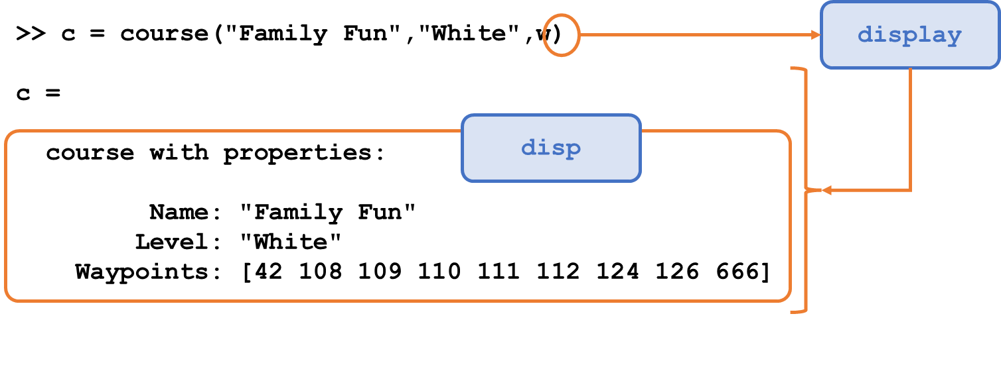
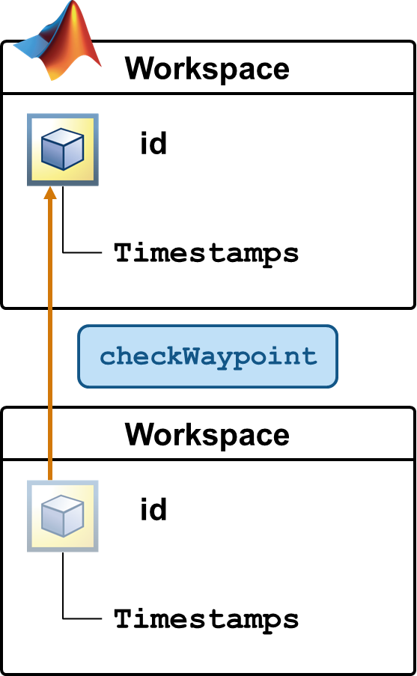
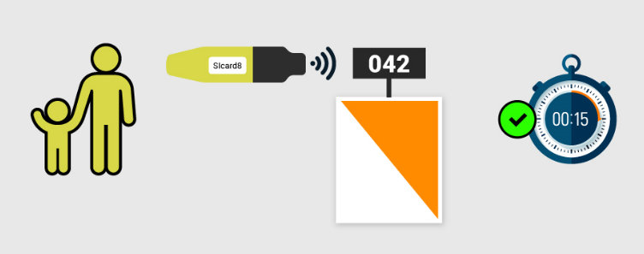
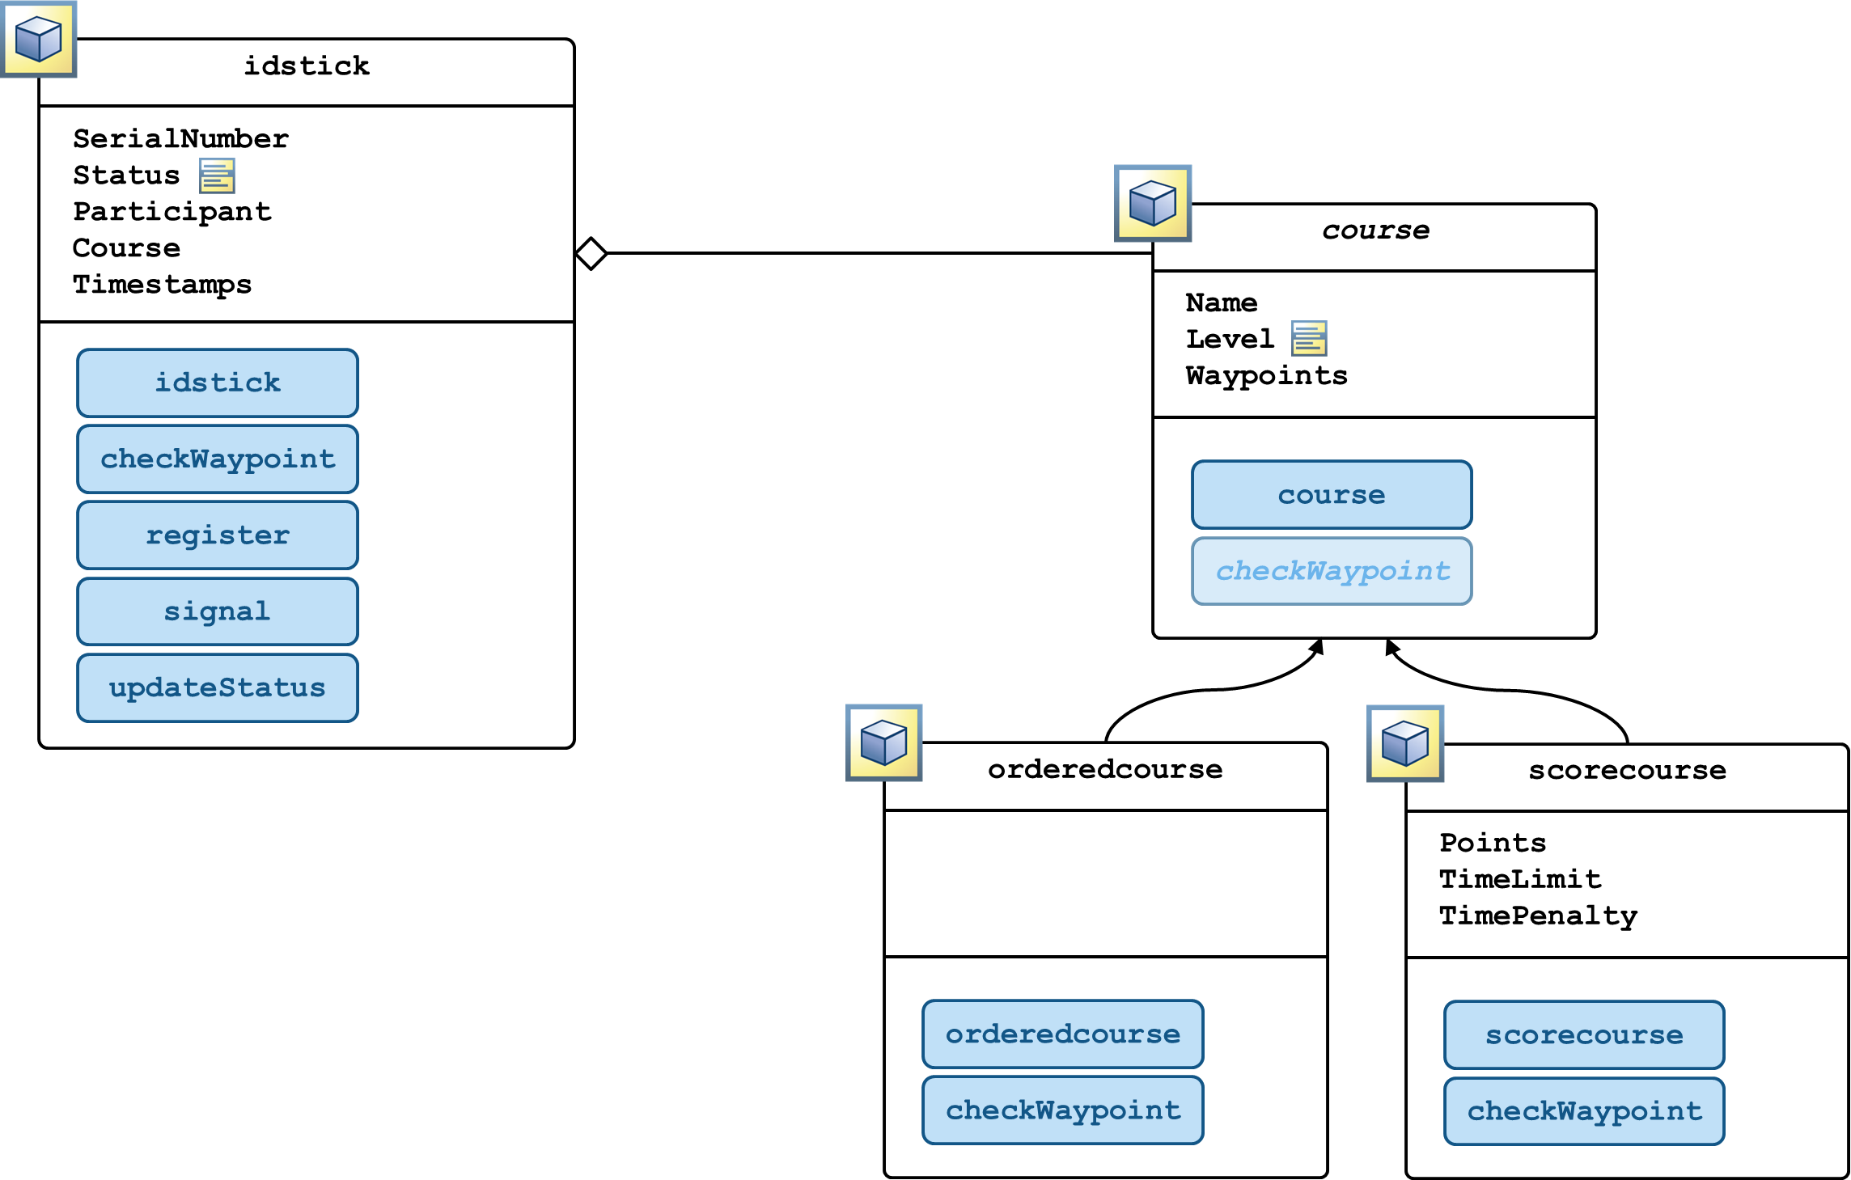
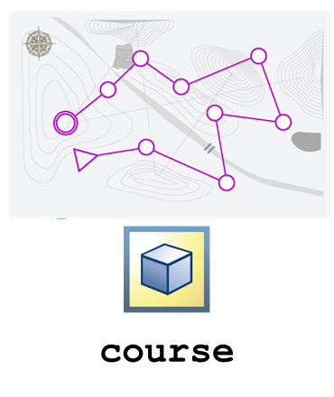
Object-Oriented Programming Onramp
Free, short course on defining custom variables, or “objects,” in MATLAB to model real-world systems
Short videos, hands-on exercises, automated assessments, & immediate feedback
Learn by working through an example of simulating an electronic ID stick for tracking runners at an orienteering event
Topics include:
Using custom objects to simulate a physical system
Writing class definitions to define custom data types
Adding functionality to custom class definitions
Adding protections to make classes robust and easy to use
Visit https://matlabacademy.mathworks.com/details/object-oriented-programming-onramp/oroop for more details

Slide 18
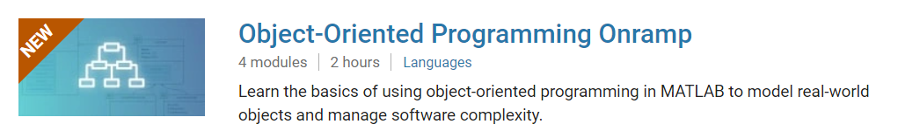
TO DO
Go to https://matlabacademy.mathworks.com/
Log in to your MathWorks account
Launch Object-Oriented Programming Onramp

Slide 19
Prizes
Complete at least 50% of Object-Oriented Programming Onramp to be eligible for any prize
Bring your laptop when you come to collect the prize
Follow Us on Facebook!
Find us on Facebook at [Insert Facebook Group Name]

